Slide 1
Computers
What are they anyway?

Slide 2
Question…
What is a computer?
Come up with the best answer you can on your table.

Slide 3
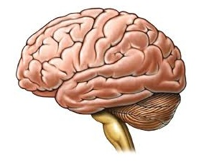
What is a computer?
X
A computer is a machine.
They don’t have brains like us — they can’t think or have ideas.
Computers can follow stored instructions and solve problems.

Slide 4
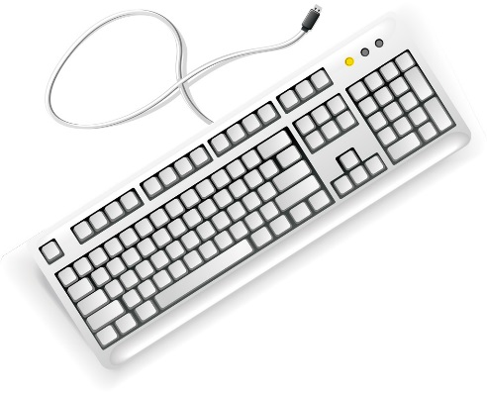

What is a computer?
INPUT

Slide 5
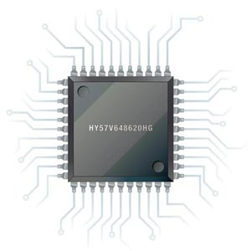
What is a computer?
INPUT
PROCESS

Slide 6
What is a computer?
INPUT
PROCESS
OUTPUT

Slide 7
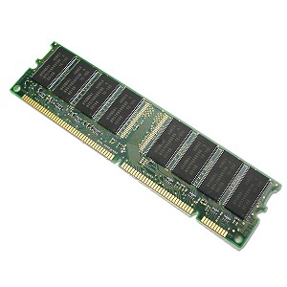
What is a computer?
INPUT
PROCESS
OUTPUT
MEMORY

Slide 8
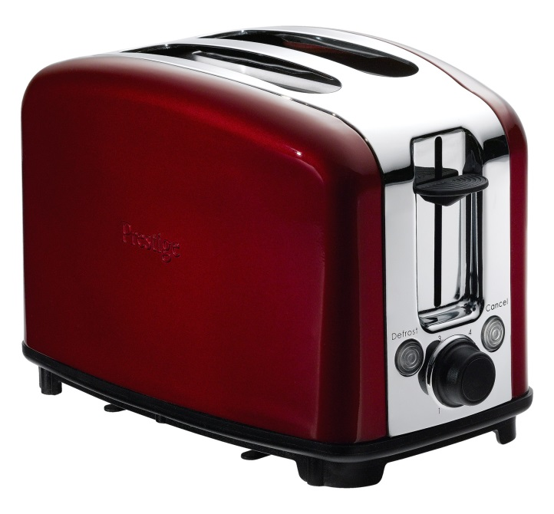
Computer or not a computer?

Slide 9

Computer or not a computer?

Slide 10
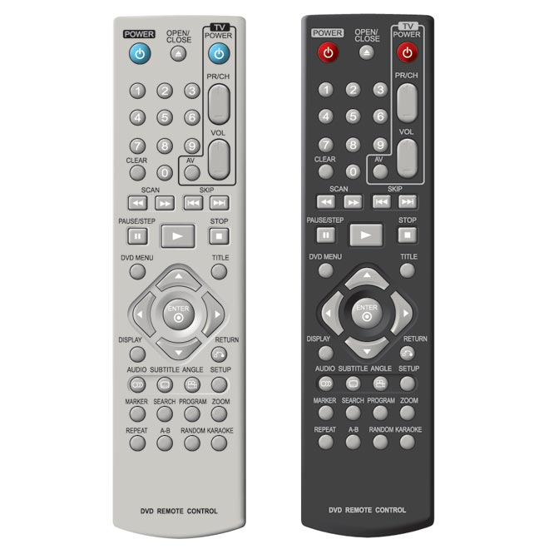
Computer or not a computer?

Slide 11
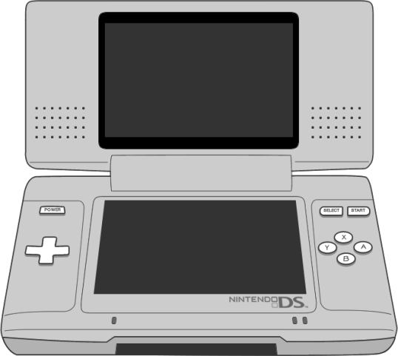
Computer or not a computer?

Slide 12
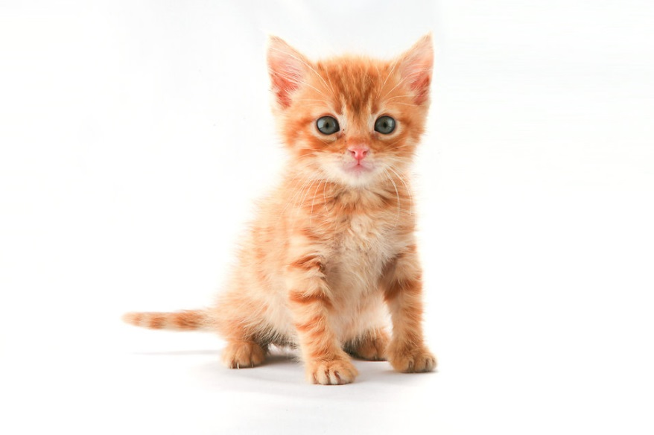
Computer or not a computer?

Slide 13
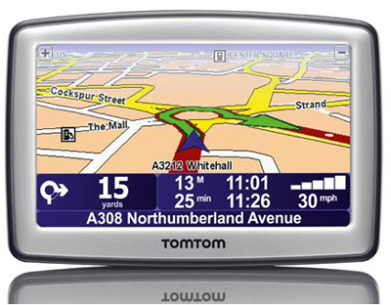
Computer or not a computer?

Slide 14
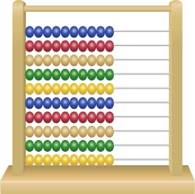
Computer or not a computer?

Slide 15
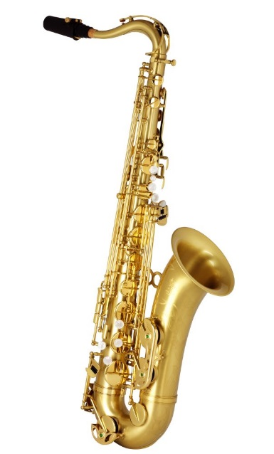
Computer or not a computer?

Slide 16
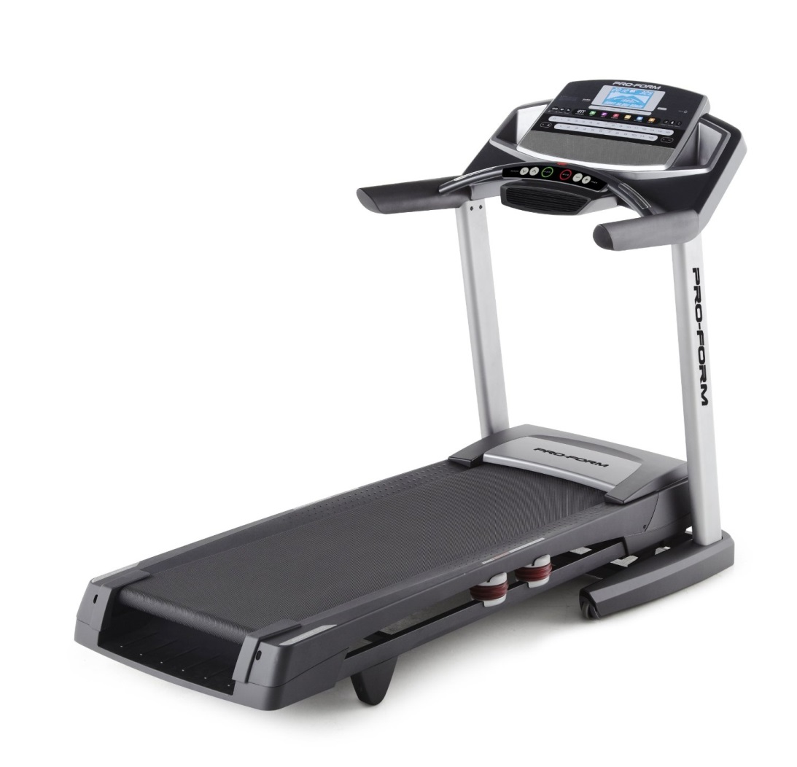
Computer or not a computer?

Slide 17
Input devices
INPUT
PROCESS
OUTPUT
MEMORY

Slide 18
Output devices
INPUT
PROCESS
OUTPUT
MEMORY

Slide 19
The interesting bit
INPUT
PROCESS
OUTPUT
MEMORY

Slide 20
Computers in everyday life
Hand-out 1
Activity in the day | Computers that are involved
Breakfast—microwaved porridge
Arrange to meet a friend on way to bus stop
Get on the bus to school
Get a hot chocolate from the canteen at school
Tutor time
Maths lesson
Breaktime
Lunch
At an afterschool club
Go to Churchill Square to get a new top
Home—TV, food, tablet and bed

